Slide 1





UNDERSTANDING OF SODIUM LOOP
AND
GAPS IN HSD AND HSD
By Jyotiraditya Kuanar
UNDER GUIDANCE OF
DR RAJESH GANESAN
ASSOCIATE DIRECTOR
SO/H, MCD, MC&MFCG

Slide 2
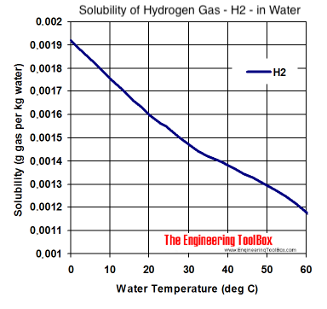

SODIUM LOOP
Reactor Heat Transfer System
  Reactor uses primary and secondary sodium loops to transfer heat from fuel rods to steam generators.
  Heat moves from primary → secondary loop via the Intermediate Heat Exchanger (IHX), then to steam.
Need for Sodium Purification
  Sodium purity degrades due to formation of hydrides and oxides from dissolved hydrogen and oxygen at high temperatures.
  Impurities must be removed to maintain safe and efficient reactor operation.
01

Slide 3
SODIUM LOOP(CONTD.)
Cold Trap Working Principle
  Sodium is cooled from ≈525 °C to ≈120 °C inside the cold trap.
  Lower temperature reduces impurity solubility (per Vissers & Noden equation), causing hydrides/oxides to crystallize.
  Sodium flows through stainless-steel mesh, which traps the crystals; purified sodium exits the trap.
Sources of Hydrogen During Normal Operation
  Even without leaks, steam reacts with iron in steam generator tubes → iron oxide + hydrogen.
  Hydrogen diffuses into sodium and is detected; may cause false alarms without proper trapping.
Operational Requirements
  Constant sodium flow through cold trap is essential.
  A 20% drop in flow (from plugging indicator) signals mesh saturation and need for regeneration.
  Heat removal rate must match reactor heat generation for stable operating temperature.
02

Slide 4
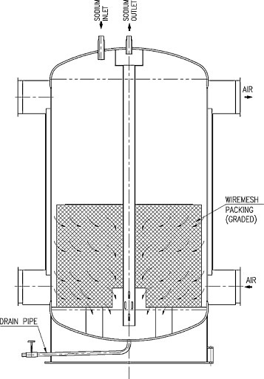
SODIUM LOOP(STRUCTURE)
03

Slide 5
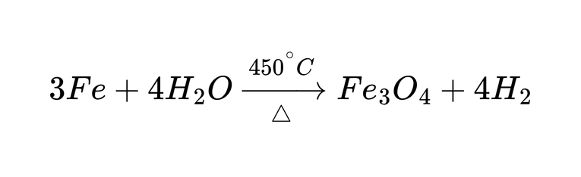
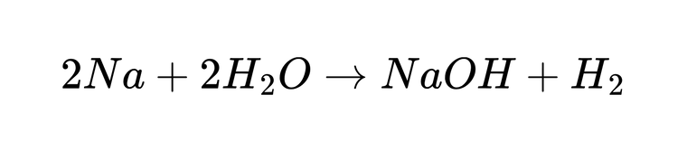
SODIUM LOOP(REACTIONS THAT CAUSE HYDROGEN)
Unavoidable:
Avoidable:
04

Slide 6
GAPS IN SENSORS
ECHM:
  Cracks/pores in electrolyte and iron casing cause drift.
  Voids lead to unstable EMF and poor repeatability.
  Sensor lifetime limited by corrosion and material degradation.
  Need to explore new electrolytes and hydrogen‑diffusion materials.
SIP:
  Other gases interfere and the sensor reacts slowly to hydrogen changes.
  Needs very high heat to operate, causing drift and material damage.
  Electrodes get poisoned, materials degrade, sealing is difficult, and calibration is complex.
  Hard to miniaturize and poses safety risks when used with hot hydrogen environments.
05

Slide 7
GAPS IN SENSORS
TCD:
  Temperature-dependent sensitivity: TCD and SnO₂ output varies strongly in 250–400°C transition region.
  Flow-rate & ambient drift: MFC temperature sensitivity causes baseline instability in HAD output.
  Nickel coil aging: Oxidation reduces hydrogen diffusion efficiency and slows response time.
  TCD baseline drift: Uncorrected drift up to ±200 mV makes detection of low ppm hydrogen unreliable.
SnO2:
  SnO₂ instability: Surface poisoning, humidity sensitivity, and long-term resistance drift affect accuracy.
  No correlation model: No established relationship between argon-phase H₂, sodium-phase H₂, EMF, and temperature.
  Response-time mismatch: TCD and SnO₂ respond at different speeds; synchronisation is not established.
  Life-time Issues: Short lifespan at full operating condition.
06

Slide 8
EXPO TECH
  Hydrogen Sensor:
  Nitrogen Dioxide Sensor:
  Ammonia Sensor:
  Methane Sensor:
  Thermal Imaging:
  HEPA:
  MCG:
07

Slide 9
THANK YOU
08

